Slide 1

HOUSE SALES IN KING COUNTRY REGRESSION
PREPARED BY
PRIYA SUHAG
ABHISHEK S CHOUDHARI
SHIVAM KUMAR
ADITYA SHRIVASTAVA
AMIT KUMAR SINGH

Slide 2
Problem Statement
Determine the prices of Houses based on different factors such as sqft_living, Bed rooms, No of Floors, yr_renovated etc and calculating the regression models to finding out which will be the best model to get the best results.

Slide 3
PIPELINE
Data Cleaning
Feature
Engineering One
Hot Encoding
Outlier Analysis
Model Creation

Slide 4
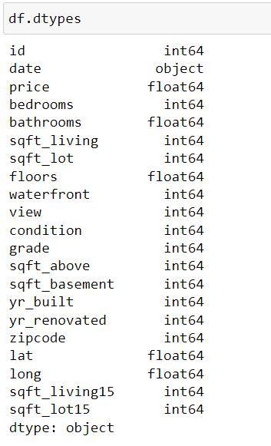
DATASET DETAILS
The Data Is Taken From House Salesdata With 21613 Instances And 21 Attributes.
Feature Standardization Was Performed On All Numeric Data Variables.
The Dataset Was Split Into Train-test Using Scikit-package.

Slide 5
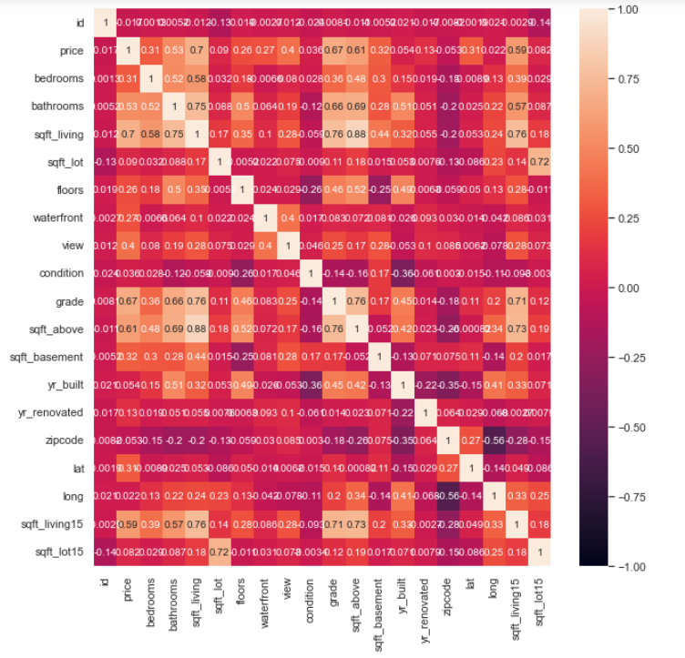
CORRELATION HEATMAP

Slide 6
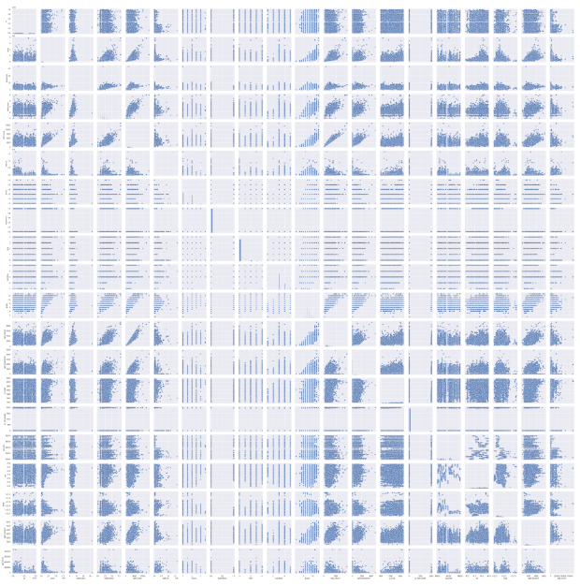
PAIRWISE RELATIONSHIP

Slide 7
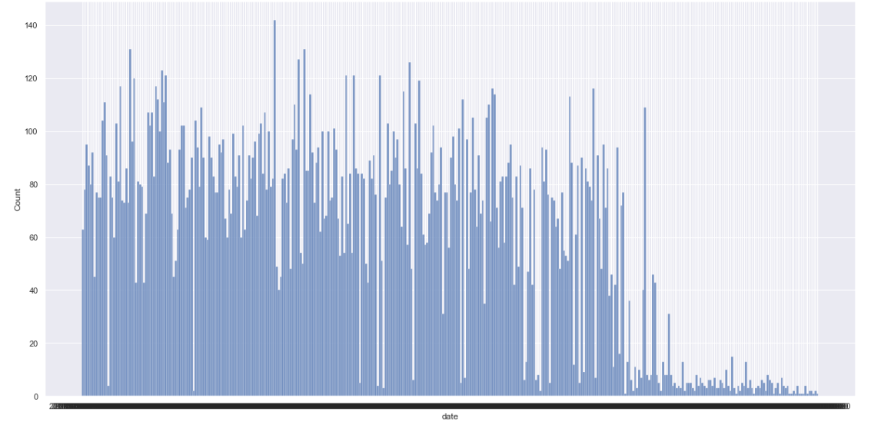
HISTOGRAM FOR A FEW CATEGORICAL VARIABLES

Slide 8
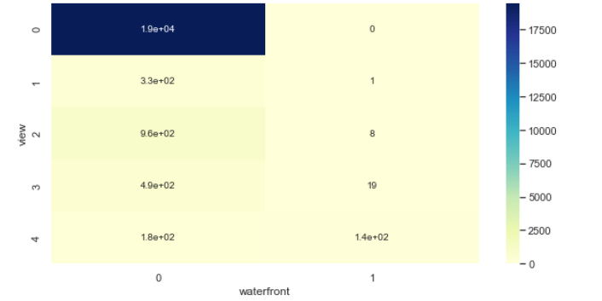
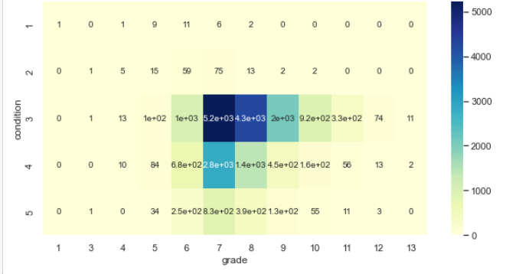
CHI-SQUARE ANALYSIS
VIEW AND WATERFRONT
CONDITION AND GRADE

Slide 9
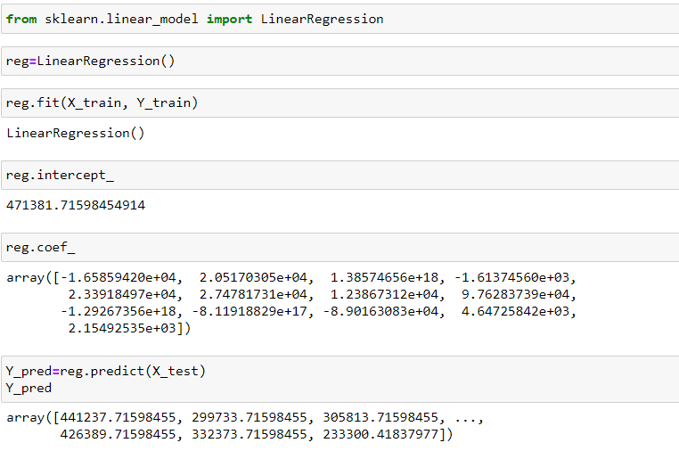
Linear Regression

Slide 10
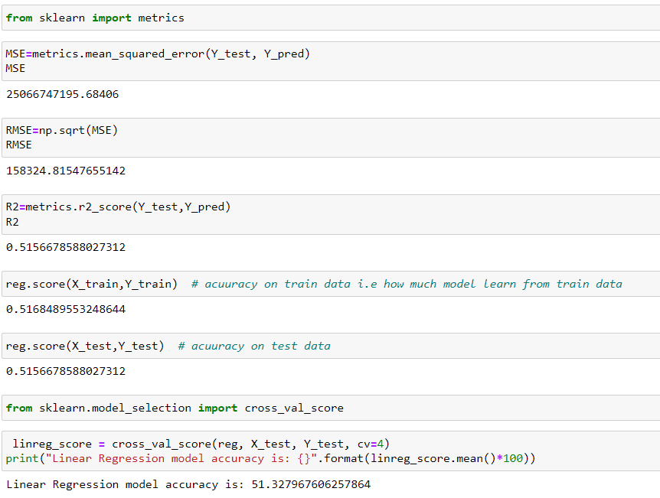

Slide 11
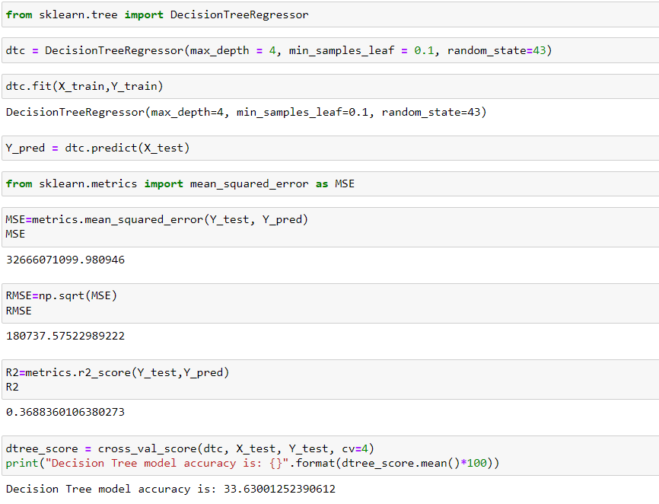
Decision Tree Model

Slide 12
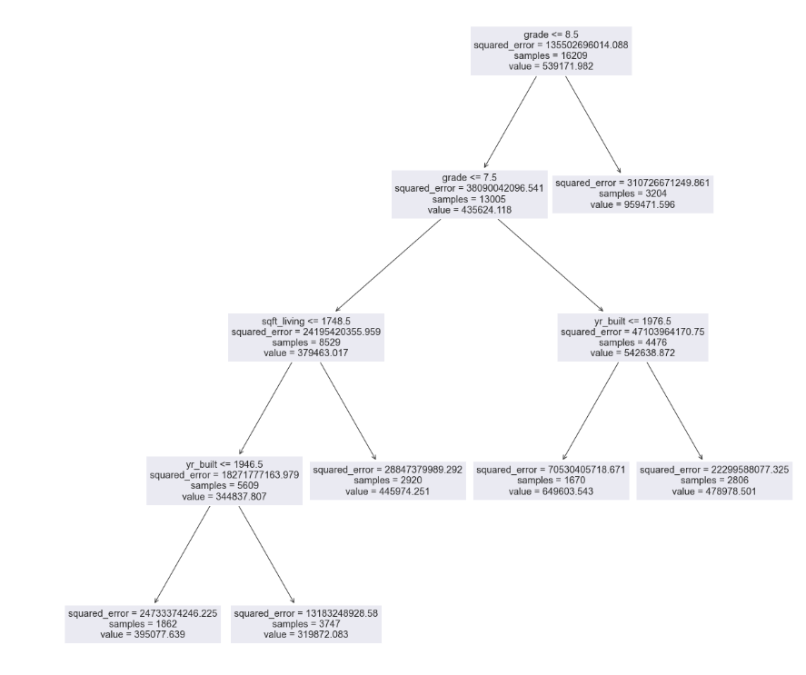

Slide 13
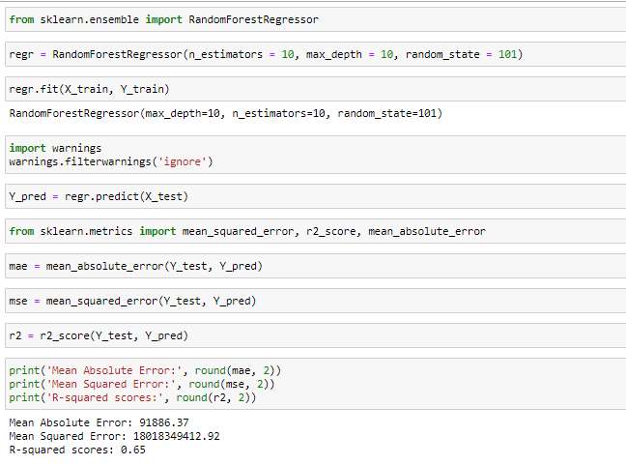
Random Forest Model

Slide 14
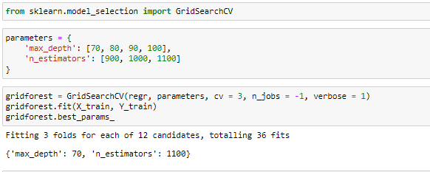
Hypertuning Grid search CV

Slide 15
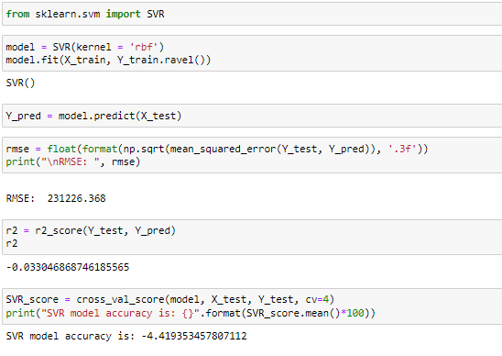
SVR Model

Slide 16
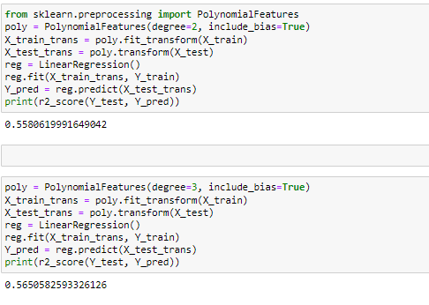
Train a polynomial regression model with degrees 2, and 3 and compare its performance with other models

Slide 17
Challenges
Chi Square Analysis To Find Out The Relation Between Two Variables
Researched About Support Vector Regression And Implemented It Using Scikit Learn.
Used Polynomial And Multiple Linear Regression In Order To Compare The Performance Of Both The Models.

Slide 18
Learnings
Time management
Communication

Slide 19
Thank you

